Slide 1
Pearson BTEC Level 3 National Extended Certificate in Health and Social Care

Slide 2
Unit guide Students will study four units. Units 1,3 and 5 are outlined as mandatory by the exam board. The fourth unit will be chosen by the subject teacher.

Slide 3
Assessment outline
Unit 1: Human Lifespan Development
• Written exam set and marked by Pearson.
• 1.5 hours. • 90 marks. Jan and May/June
Unit 2: Working in Health and Social Care
• Written exam set and marked by Pearson.
• 1.5 hours. • 80 marks. Jan and May/June First assessment May/June

Slide 4
Unit 1: Human Lifespan Development
Assessment outcomes
AO1 Demonstrate knowledge of physical, intellectual, emotional and social development across the human lifespan, factors affecting human growth and development and effects of ageing Command words: describe, discuss, evaluate, identify, justify, to what extent Marks: ranges from 3 to 6 marks
AO2 Demonstrate understanding of physical, intellectual, emotional and social development across the human lifespan, factors affecting human growth and development and effects of ageing Command words: describe, discuss, evaluate, explain, justify, outline, to what extent, which Marks: ranges from 1 to 6 marks
AO3 Analyse and evaluate information related to human development theories/models and factors affecting human growth and development Command words: evaluate Marks: 10 marks
AO4 Make connections between theories/models in relation to human development, factors affecting human growth and development and effects of ageing Command words: discuss, evaluate, justify, to what extent Marks: ranges from 10 to 12 marks

Slide 5
Unit 2: Working in Health and Social Care
Learning aims In this unit you will:
A Examine principles, values and skills which underpin meeting the care and support needs of individuals
B Examine the ethical issues involved when providing care and support to meet individual needs
C Investigate the principles behind enabling individuals with care and support needs to overcome challenges
D Investigate the roles of professionals and how they work together to provide the care and support necessary to meet individual needs.

Slide 6
Unit 5: Meeting Individual Care and Support needs. Internally assessed.

Slide 7
Unit 5: Meeting Individual Care and Support needs. Assessment criteria:

Slide 8
BTEC Tech Health and Social Care
Services and Values
The Spec!!!
PASS | Demonstrate the care values independently in a health or social care context. Describe positive and negative aspects of own demonstration of the care values and comment on aspects of feedback.
MERIT | Demonstrate the care values independently in a health or social care context, making suggestions for improvements of own application of the care values that incorporate feedback.
DISTINCTION | Assess the suitability of health and social care services for individuals in a given scenario, making justified and realistic suggestions for how barriers for one service can be overcome.
Care Values
Empowering and promoting independence. | Involving the individuals where possible in making choices e.g. what treatment they should have.
Respect | Respecting service users’ needs, beliefs and identity.
Maintaining confidentiality | When dealing with records, avoid sharing information inappropriately e.g. gossiping.
Preserving dignity | Help individuals to maintain privacy and self-respect.
Effective communication | Effective communication that displays empathy and warmth.
Safeguarding and duty of care | Maintaining a healthy and safe environment by keeping individuals safe from harm.
Anti-discriminatory practice | Being aware of types of unfair discrimination and avoiding discriminatory behaviour.
Self – Assessment Tips
1 | Identify specific and relevant examples of performance throughout the assessment.
2 | Highlight your accomplishments make sure you accurately describe your strengths.
3 | Be honest – it is very likely your teacher will have a good understanding of your strengths and areas for development.
4 | Use the feedback provided and if you don’t understand it ask for help!
5 | Research different ways that you could develop your performance.
6 | Stay positive – even when discussing your areas for development. No one is perfect!
7 | Create targets for development – identify how you can improve and how long it should take you to develop your weaknesses.
Basics
Identify | Establish or indicate who or what (someone or something) is.
Describe | Give a detailed account in words of.
Explain | Make clear to someone by describing it in more detail or revealing relevant facts.
Assess | Give careful consideration to all the factors or events that apply and then identify which are most important, giving reasons. You must also give the advantages and disadvantages and say which one is best
Evaluate | Give careful consideration to the advantages and disadvantages and then explain why they are advantages and disadvantages. Decide which factor is the most important and explain your reasons.
Analyse | Identify the key factors and how they are linked and the explain the importance and relevance of each one.
Case Studies
Empowering/ Independence: James has arthritis. His joints are sore and swollen. He used to be a journalist and write a lot. He wants to discuss his meal choices and how to be as independent as possible whilst eating.
Respect: Nathan is about to have his 3rd birthday. His mum wants to invite everyone from his nursery to his party and is preparing invitations. Some of Nathan’s friends are Jehovah’s Witness but Nathan’s mum wants them to be there without being disrespectful to their beliefs.
Confidentiality: The medical records of 26 million patients are embroiled in a major security breach amid warnings that the IT system used by thousands of GPs is not secure. The Information Commissioner is investigating concerns that records held by 2,700 practices - one in three of those in England - can be accessed by hundreds of thousands of strangers.
Dignity: Ana is receiving palliative care, she recently had a course of chemotherapy and has lost her hair. She had always been very particular about her appearance. She is nearing the end of life and Justine is helping her with her care in the hospice, Justine wants to maintain her dignity where possible.
Communication: The lack of communication across the NHS is "completely shocking", the Health Secretary said yesterday as he disclosed that 11 people died last year after being given the wrong medication. The NHS needs to improve communication to staff and patients.
Safeguarding/ duty of care: There were 12 chances to save the life of this eight year old girl. Instead, she died of 128 injuries. On 25 February 2000, months of abuse and neglect finally overcome Victoria Climbié and she’s declared dead. The torture she’s suffered includes starvation, cigarette burns, repeated beatings with bike chains and belt buckles. And hammer blows to her toes. Many will blame the Haringey social worker, for not doing more to prevent the abuse and the social care system that utterly failed to protect an innocent child.
Anti-discriminatory practice: Violet aged 84, had an appointment to have an operation on a bunion on her big toe. However, because of her angina, she was sent for a heart scan. She said: "They found that it was not angina, but a leaky valve. "I asked if I could have this fixed. The attitude from doctors was: 'What are you bothered about, at your age?'.
Sentence Starters
In addition to… | Alternatively… | For instance…
Another point… | For example… | Whereas…
This can be illustrated by…. | However… | Generally…

Slide 9
BTEC Tech Health and Social Care
Services and Values
The Spec!!!
PASS | Explain how health and social care services meet the needs of individuals in a given scenario. Explain how barriers could affect the use of one health and social care service for an individual in a given scenario.
MERIT | Analyse the extent to which health and social care services meet the needs of individuals in a given scenario, explaining how barriers for one service can be overcome.
DISTINCTION | Assess the suitability of health and social care services for individuals in a given scenario, making justified and realistic suggestions for how barriers for one service can be overcome.
Health and Social Care Services
HEALTH CARE | SOCIAL CARE
Primary: GPs, dental care, optometry, community health care. | Children and young people: foster care, residential care, youth work.
Secondary and tertiary care: specialist medical care. | Adults or children with specific needs: residential care, respite care, domiciliary care.
Allied health professionals: physiotherapy, occupational therapy, speech and language, dieticians | Older adults: residential care, domiciliary care. Informal care: relatives, friends, neighbours.
Key Words
Primary care | Health care provided in the community for people making an initial approach for advice or treatment.
Secondary care | Medical care that is provided by a specialist or facility upon referral by a primary care
Tertiary care | Specialized consultative care, usually on referral .
Allied health professionals | Health care professions distinct from nursing, medicine, and pharmacy.
Residential care | Long-term care given to adults or children who stay in a residential setting (not own home).
Respite care | Temporary care of a sick, elderly, or disabled person, providing relief for their usual carer.
Domiciliary care | Help with personal care and other practical household tasks.
Optometry | Occupation of measuring eyesight, prescribing corrective lenses, and detecting eye disease.
Physiotherapy | Treatment of disease, injury, or deformity by physical methods such as massage, heat treatment, and exercise.
Occupational therapy | The use of particular activities as an aid to recuperation from physical or mental illness.
Dieticians | An expert on diet and nutrition.
Basics
Identify | Establish or indicate who or what (someone or something) is.
Describe | Give a detailed account in words of.
Explain | Make clear to someone by describing it in more detail or revealing relevant facts.
Assess | Give careful consideration to all the factors or events that apply and then identify which are most important, giving reasons. You must also give the advantages and disadvantages and say which one is best
Evaluate | Give careful consideration to the advantages and disadvantages and then explain why they are advantages and disadvantages. Decide which factor is the most important and explain your reasons.
Analyse | Identify the key factors and how they are linked and the explain the importance and relevance of each one.
Sentence Starters
In addition to… | Alternatively… | For instance…
Another point… | For example… | Whereas…
This can be illustrated by…. | However… | Generally…
Barriers
Physical barriers Objects that prevent the individual from getting to where they should go. | Cultural/Language barriers Services that affect someone's culture or that they cannot understand because they don’t speak that language. | Intellectual barriers Cannot access services because they did not know about them.
Sensory barriers Individuals unable to access services because they are death, blind etc. | Psychological barriers Affecting the way an individual thinks about a service. | Resource barriers Services not available due to lack of staff or money.
Social barriers Cannot access services because they struggle in social situations. | Geographical barriers The distance individuals have to travel to access services. | Financial barriers The cost of accessing services.
Case Studies
Case study 1: Robert has been diagnosed with cancer. He needs to have radiotherapy treatment which is in a specialist hospital which is 35miles away. The treatment made him feel to ill to drive.
Case Study 2: Daisy is 76years old and has suffered a stroke. Her mobility is good but she gets confused. She is trying to decide whether to stay at home with support or move to a residential home.
Case Study 3: Angelika is 29years old and has just moved to the UK she speaks little English. She has just found out she is pregnant. Angelika is worried because she has no one to go with and the hospital is 25miles away – she cannot drive.

Slide 10
Health and Social Care Services
How many examples of health and social care services can you name?
Think about your local area, or the journey to school

Slide 11
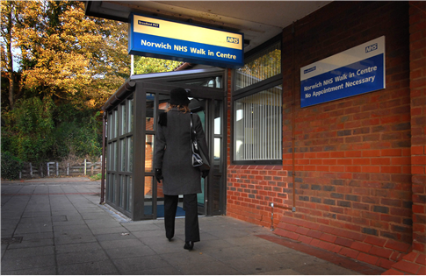
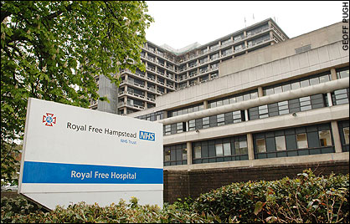
Health and Social Care Services
How many examples of health and social care services can you name?
Think about your local area, or the journey to school

Slide 12
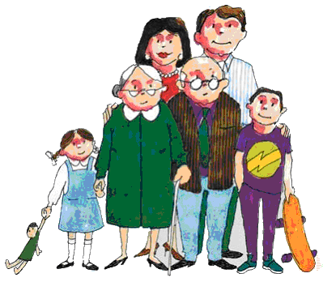
Health visitor
Jobs in Health and Social Care ….
Health care support assistant
Psychologist
Physiotherapy
Social workers
Doctors/ Nurses/Surgeon/Paediatrician
Dentists
Teachers
Pharmacist
Counsellor
Nursery Nurse
Speech and language therapist
Speech Therapist
Bilingual assistant
Occupational therapist
Pathologist
Care Worker
Task 4 - B

Slide 13
The National Health Service (NHS) is divided into two parts
Primary Care – The first point of contact for all patients , your GP, for example
Secondary Care – The services a patient may require after contact with the primary care service. A referral to a specialist, for example
Health and Social Care Services

Slide 14
Health and social care services are also divided into statutory and non-statutory services
Statutory services have to be provided by law. The government or local government provides them. They include the NHS, Social Services and nursery schools.
Non-statutory services are provided by organisations other than the state, and include private companies, charities and volunteers, such as BUPA or Age Concern
Health and Social Care Services

Slide 15
Task for further learning:
Health and Social Care Services
Research and investigate one health or social care service in detail and produce a ‘Guide’ to that service. You could include:
What service they provide
Who they provide the service for
Where they can be found
When people need their services
How service users can access them
Why their services are required

Slide 16
Useful websites
https://qualifications.pearson.com/en/qualifications/btec-nationals/health-and-social-care-2016.html
https://www.careuk.com/care-homes/cavell-court-cringleford/news/championing-dignity-in-health-and-social-care?msclkid=188951b9efb91a6f81f00f511d950601&utm_source=bing&utm_medium=cpc&utm_campaign=Cavell%20Court%20-%20DSA%20-%20National&utm_term=cavell-court&utm_content=Cavell%20Court%20-%20DSA%20-%20National
https://www.hse.gov.uk/healthservices/links.htm

